Slide 1


Data Analytics NYC Taxi Trip Project
A Hypothesis testing approach in Python.

Slide 2

Problem Statement
In the fast-paced taxi booking sector, making the most of revenue is essential for long-term success and drive happiness.
Our goal is to use data-driven insights to maximise revenue streams for taxi drivers in order to meet this need. Our research aims to determine whether payment methods have an impact on fare pricing by focusing on the relationship between payment type and fare amount.

Slide 3
Research Question
Is there a relationship between total fare amount and payment type?
Can we nudge customers towards payments methods that generate higher revenue for drivers, without negatively impacting customer experience?

Slide 4
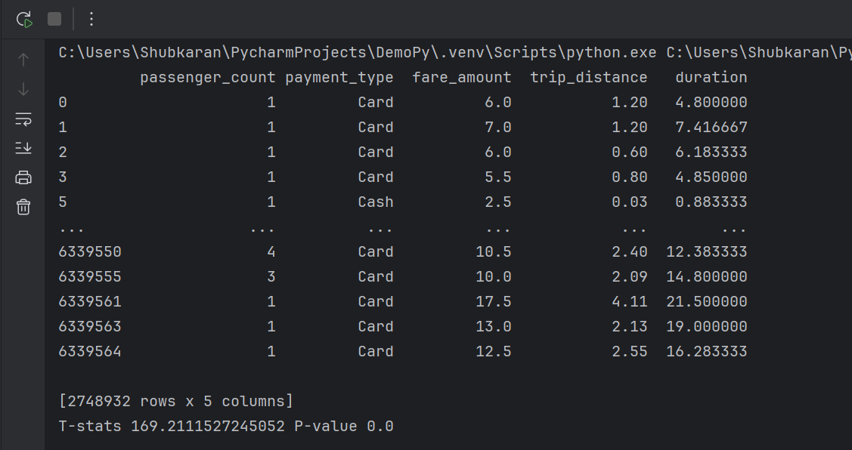
Data Overview
For this analysis, we utilised the comprehensive data set of New York Taxi Trip records, used data cleaning and feature engineering procedures to concentrate solely on the relevant columns essential for our investigation.
Relevant Columns used for this research:-
passenger_count (1 to 5)
payment_type (card or cash)
fare_amount
trip_distance (miles)
duration (minutes)

Slide 5
Methodology
Step | Description
Descriptive Analysis | Performed statistical analysis to summarize key aspects of the data, focusing on fare amounts and payment types.
Hypothesis Testing | Conducted a T-test to evaluate the relationship between payment type and fare amount, testing the hypothesis that different payment methods influence fare amounts.

Slide 6
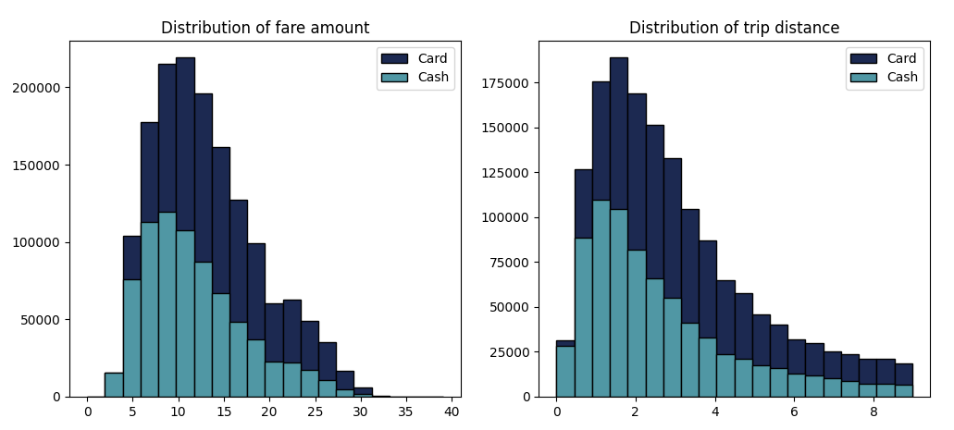
Journey Insights
Customers paying with Card tend to have a slightly higher average trip distance and fare amount compared to those paying with cash
Indicates that customers prefers to pay more with cards when they have high fare amount and long trip distance

Slide 7
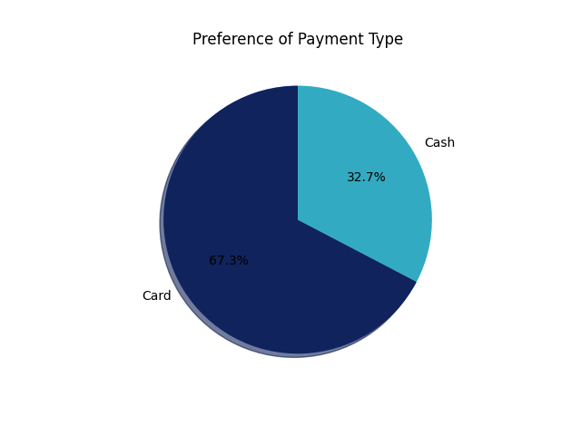
Preference of Payment Types
The proportion of customers paying with cards is significantly higher than those paying with cash, with card payments accounting for 67.5% of all transactions compared to cash payments at 32 .5%
This indicates a strong preference among customers for using card payments over cash, potentially due to convenience, security, or incentives offered for card transactions.

Slide 8
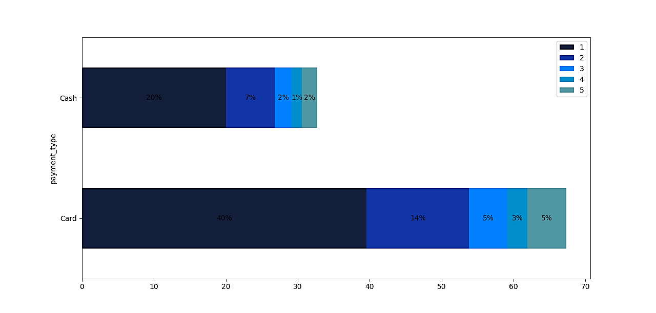
Passenger Count Analysis
Among card payments, rights with a single passenger comprise the largest proportion constituting 40.08% of all card transactions.
Similarly, cash payments are predominantly associated with single passenger rides, making up 20.04% of all cash transactions.
There is a noticeable decrease in the percentage of transactions as the passenger count increases suggesting that larger groups are less likely to use taxis or may opt for alternative payment methods

Slide 9
Hypothesis Testing
Null hypothesis:- There is no difference in average fare between customers who use credit cards and customers who use cash.
Alternative hypothesis:- There is a difference in average fare between customers who use credit cards and customers who use cash.
With a T-statistic of 165.5 and P-value of less than 0.05, we reject the null hypothesis, suggesting that there is indeed a significant difference in average fare between the two payment methods.

Slide 10



Recommendations
Encourage customers to pay with credit cards to capitalise on the potential for generating more revenue for taxi cab drivers.
Implement strategies such as offering incentives or discounts for credit card transactions to incentivize customers to choose this payment method.
Provide Seamless and secure credit card payment options to enhance customer convenience and encourage adoption of this preferred payment method.

